Slide 1
DOCTOR VISIT ANALYSIS USING PYTHON
Thakur Aryan Singh

Slide 2
PROJECT TOPIC
The project "Doctor Visit Analysis using Python" aims to explore and analyze data related to doctor visits, leveraging Python programming for data manipulation, visualization, and predictive modeling.

Slide 3
Agenda:
The project "Doctor Visit Analysis using Python" have the following agenda outlines the key steps to be undertaken throughout the project:
Introduction: Highlight the objectives and scope of the analysis.
Data Collection and Preparation: Preprocess and clean the data to make it suitable for analysis.
Exploratory Data Analysis (EDA): Utilize visualizations to present key findings.
Predictive Modeling: Define the specific prediction task (future work).
Model Evaluation and Interpretability: Evaluate the performance of the predictive models using appropriate metrics

Slide 4
Project overview:
The "Doctor Visit Analysis using Python" project seeks to harness the power of data analysis and Python programming to gain valuable insights into the realm of healthcare. With the increasing volume of data generated in the medical field, there is a growing need to extract meaningful information to improve patient outcomes and optimize healthcare services. This project focuses on exploring data related to doctor visits, aiming to understand patterns, trends, and factors influencing these visits

Slide 5
Who are the end users?
The end users of the project "Doctor Visit Analysis using Python" can encompass a diverse group of stakeholders in the healthcare domain. These end users can benefit from the project's insights and findings to optimize healthcare services and enhance patient outcomes.
The end users of the "Doctor Visit Analysis using Python" project span across healthcare providers, hospital administrators, policy makers, insurance companies, research institutions, and public health organizations.

Slide 6
Solution and presentation
The solution for the "Doctor Visit Analysis using Python" project involves leveraging Python for comprehensive data analysis and modeling. After collecting and preprocessing relevant datasets, we conduct exploratory data analysis (EDA) to identify patterns and correlations in doctor visits. Utilizing machine learning algorithms, we develop predictive models to forecast appointment no-shows and patient readmission rates. Optional time-series analysis allows us to understand temporal trends, while NLP techniques extract insights from patient reviews or notes. Ethical considerations guide our analysis, ensuring data privacy and responsible use of results. The project culminates in actionable insights for healthcare providers, administrators, policymakers, and insurers, empowering them to optimize resources, improve patient care, and make informed decisions for enhanced healthcare services.

Slide 7
HOW DID I CUTOMIZED THE PROJECT AND MAKE IT ON MY OWN
Highlighting the unique that set it apart from the existing oneaspects of my solution
From the analysis, the following features or key insights can be highlighted:
Gender Distribution: The analysis shows the distribution of visits based on gender, providing insights into the number of visits made by male and female patients.
Age Distribution: The age distribution analysis gives an overview of the age groups of patients visiting the hospital, helping understand the patient demographics.
Income Distribution: The income distribution analysis provides insights into the income levels of the patients in the dataset.
Illness Distribution: The distribution of illness types gives an overview of the prevalence of different illnesses among the patients.

Slide 8
Reduced Activity Due to Illness: This analysis explores the number of days of reduced activity due to illness, giving insights into the impact of illnesses on patient activity.
Health Status: The health status distribution reveals the distribution of different health statuses among the patients.
Based on the analysis , several aspects can be considered innovative or remarkable:
Multifaceted Exploration: The analysis covers a wide range of variables, including gender, age, income, illness type, reduced activity days, health status, insurance types, and chronic illnesses. This comprehensive exploration allows for a holistic understanding of the dataset and potential correlations between different factors.
Data-Driven Visualizations: The analysis utilizes various data visualizations, such as bar plots, box plots, histograms, heatmaps, and count plots. These visualizations effectively convey information, making it easier for stakeholders to grasp insights and trends.
Contextual Grouping: The analysis introduces contextual grouping of data by creating age groups and income groups, providing better insights into how different age and income brackets may influence various health-related aspects.

Slide 9
Insightful Correlation Matrix: The correlation matrix helps identify relationships between numerical variables, offering insights into how certain factors might be interconnected, such as illness type and reduced activity days.
Proportion Analysis: The analysis includes proportion-based insights, showing the percentage of patients with chronic illnesses by gender and insurance type. This allows for a more nuanced understanding of how different factors affect health conditions.
Comparative Analysis: Several visualizations compare different variables side by side, such as average reduced activity days by illness type and insurance type. These comparisons help in making informed decisions based on various criteria.

Slide 10
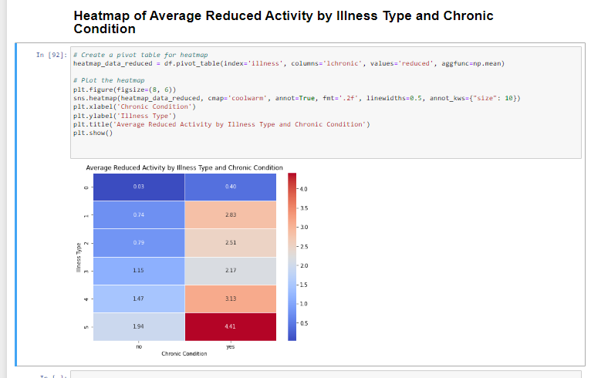
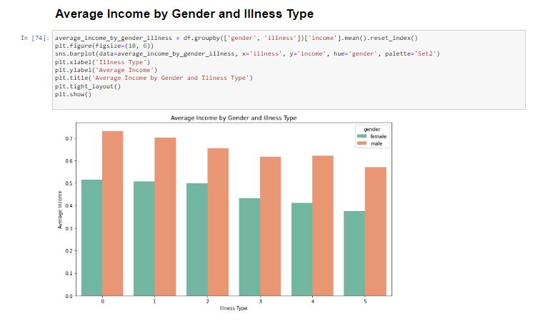
Modelling:

Slide 11
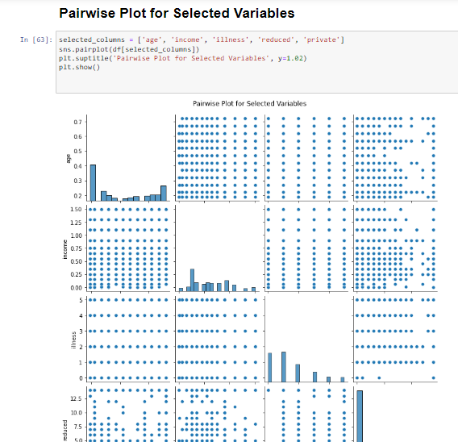
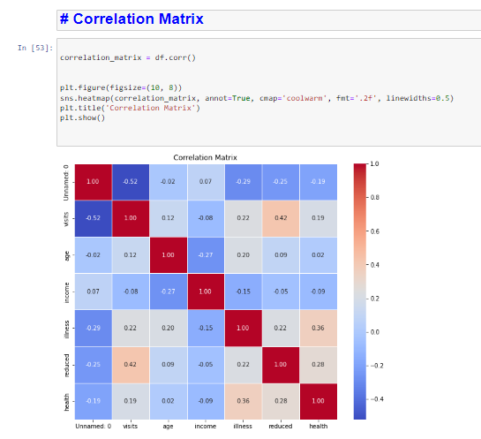
Modelling:

Slide 12
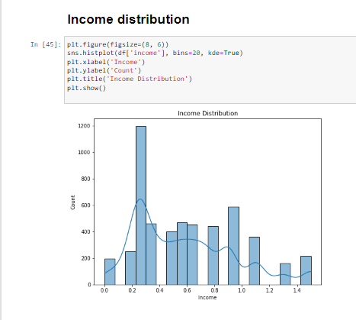
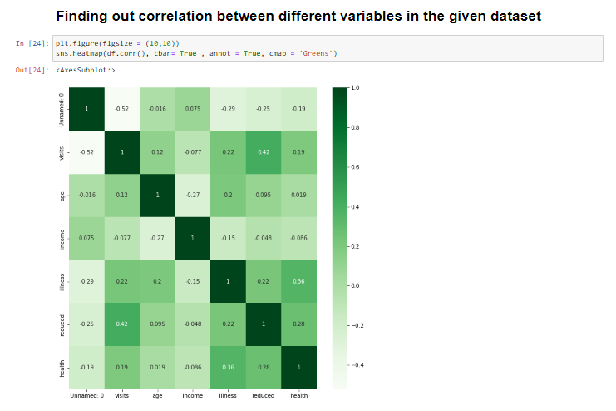
Modelling:

Slide 13
Links:
https://github.com/Thakur-aryan-singh/doctors-visit-EDA

Slide 14
RESULTS:
The results of the "Doctor Visit Analysis using Python" project can have a substantial impact on the healthcare sector, empowering healthcare providers, administrators, policymakers, and other stakeholders with evidence-based insights. These findings can lead to more effective healthcare planning, resource allocation, and patient care, ultimately contributing to improved health outcomes and patient experiences.

Slide 15
THANK YOU

